Slide 1

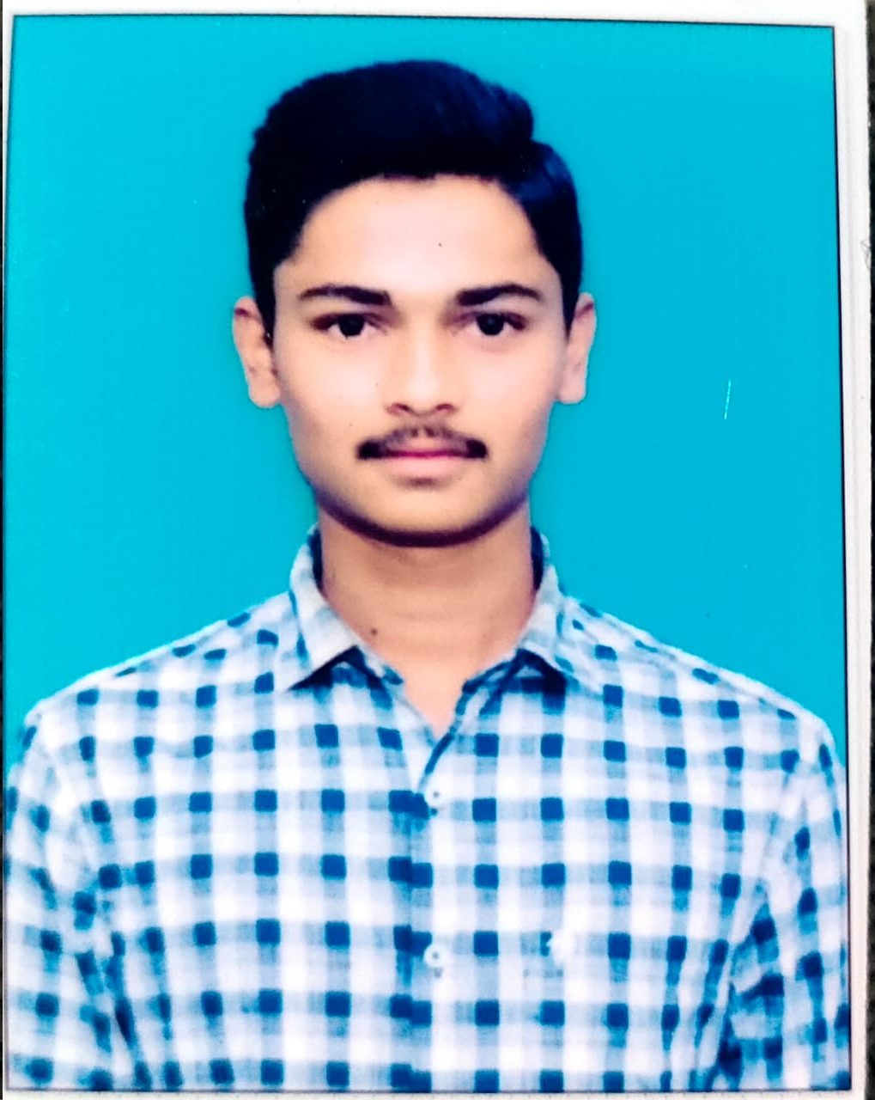
EXTERNAL QUESTION 16
(DBMS)
Presented By
T.PAVAN
22551A4448
CSE(DS)
GIET(A)
Lecture Details:
Topic Name : External Question 16
DBMS/CSE(DS) , 2-1

Slide 2
EXPERIMENT 16
16 a)Develop Programs using BEFORE and AFTER Triggers, Row and Statement Triggers and INSTEAD OF Triggers
CREATING TRIGGERS:
Syntax for creating a trigger :
CREATE [OR REPLACE ] TRIGGER trigger_name
{BEFORE | AFTER | INSTEAD OF }
{INSERT [OR] | UPDATE [OR] | DELETE}
[OF col_name]
ON table_name
[REFERENCING OLD AS o NEW AS n]
[FOR EACH ROW]
WHEN (condition)
DECLARE
Declaration-statements
BEGIN
Executable-statements
EXCEPTION
Exception-handling-statements
END;

Slide 3
EXAMPLE:
(1 ) CREATE A TRIGGER
SQL> edit C:/trigger1.sql;
set serveroutput on;
create or replace trigger trg1_csm
after insert or delete or update
on emp
for each row
when(new.eid>0)
begin
dbms_output.put_line('Trigger Fired');
end;
/

Slide 4
SQL> @ C:/trigger1.sql;
Trigger created.
SQL> select * from emp;
EID NAME SALARY BONUS
---------- ---------- ---------- ----------
101 Deepak 330000 33000
102 Jayaprakash 550000 55000
103 Trishanth 825000 82500
104 Janardhan 100000 10000
105 Swaroop 200000 20000
5 rows selected.
(2)INSERT
SQL> insert into emp values(106,'Avinash',500000,20000);
Trigger Fired
1 row created.

Slide 5
(3)UPDATE
SQL> update emp set eid=107 where name='Avinash';
Trigger Fired
1 row updated.
SQL> select * from emp;
EID NAME SALARY BONUS
------- ---------- ---------- ----------
101 Deepak 330000 33000
102 Jayaprakash 550000 55000
103 Trishanth 825000 82500
104 Janardhan 100000 10000
105 Swaroop 200000 20000
107 Avinash 500000 20000
6 rows selected.

Slide 6
(4)DELETE
SQL> delete from emp where eid=107;
1 row deleted
SQL> select * from emp;
EID NAME SALARY BONUS
------ ---------- ---------- ----------
101 Deepak 330000 33000
102 Jayaprakash 550000 55000
103 Trishanth 825000 82500
104 Janardhan 100000 10000
105 Swaroop 200000 20000
5 rows selected.

Slide 7
16 b)Write a PL/SQL program to find the sum of the digits of the number
PROGRAM:
SET SERVEROUTPUT ON;
CREATE OR REPLACE PROCEDURE CalculateDigitSum (
num_input IN NUMBER,
sum_output OUT NUMBER
)
IS
remainder NUMBER;
temp_num NUMBER;
digit_sum NUMBER := 0;
BEGIN
temp_num := num_input;
WHILE temp_num > 0 LOOP
remainder := MOD(temp_num, 10);
digit_sum := digit_sum + remainder;
temp_num := TRUNC(temp_num / 10);
END LOOP;

Slide 8
sum_output := digit_sum;
DBMS_OUTPUT.PUT_LINE('The sum of the digits of ' || num_input || ' is: ' || sum_output);
END;
/
DECLARE
input_number NUMBER := 12345; -- Replace this with your desired number
result_sum NUMBER;
BEGIN
CalculateDigitSum(input_number, result_sum);
END;
/
OUTPUT:
The sum of the digits of 12345 is: 15

Slide 9

⚫ “Whatever you want to do, do with full passion and work really hard towards it. Don’t look anywhere else” — Virat Kohli
⚫ “PEOPLE THROW STONES AT YOU CONVERT
THEM INTO MILESTONES" —
SACHIN RAMESH TENDULKAR

